Slide 1
ONLINE CLASS
GRAPH THEORY
BICTE $6^{TH}$ SEMESTER
2078/03/22
PRESENTED BY KALYAN DAHAL

Slide 2
Blocks
A connected non-trivial graph having no cut point (vertex) is called its blocks. A block of a graph is a sub-graph. Every graph is the union of its blocks.
Note: Let G be a graph and a family of paths S in G is called internally-disjoint if no vertex of G is an internal vertex of more than one path of the family.

Slide 3
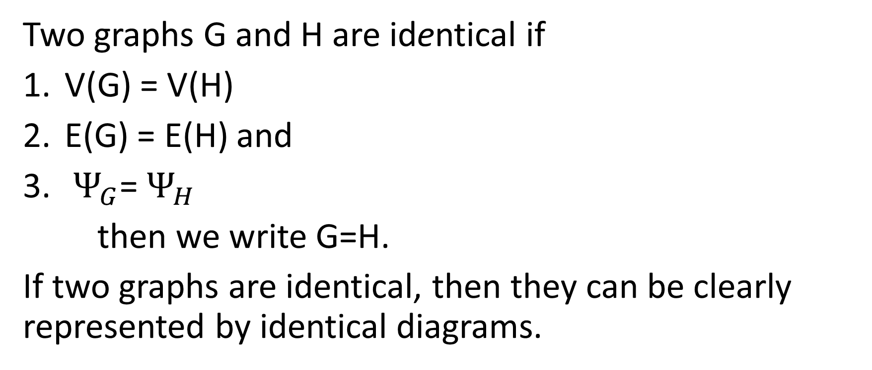
Isomorphism
Two graphs G and H are identical if
V(G) = V(H)
E(G) = E(H) and
$Ψ_{G}$= $Ψ_{H}$
then we write G=H.
If two graphs are identical, then they can be clearly represented by identical diagrams.

Slide 4
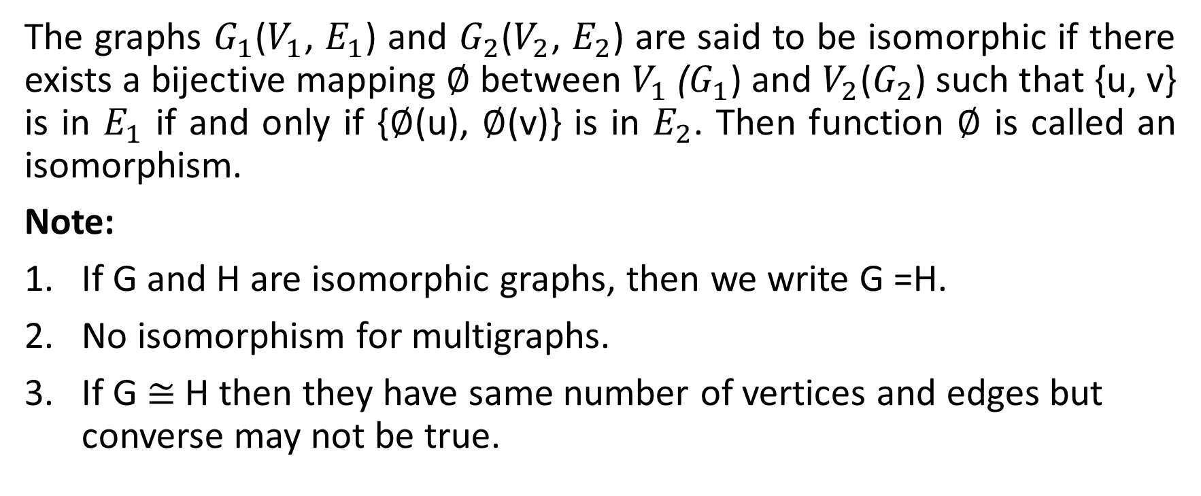
Isomorphism
The graphs $G_{1}$($V_{1}$, $E_{1}$) and $G_{2}$($V_{2}$, $E_{2}$) are said to be isomorphic if there exists a bijective mapping $∅$ between $V_{1}$($G_{1}$) and $V_{2}$($G_{2}$) such that {u, v} is in $E_{1}$ if and only if {$∅$(u), $∅$(v)} is in $E_{2}$. Then function $∅$ is called an isomorphism.
Note:
If G and H are isomorphic graphs, then we write G =H.
No isomorphism for multigraphs.
If G $≅$ H then they have same number of vertices and edges but converse may not be true.

Slide 5


Complement of a graph
Let G be a simple graph. The complement of G is the simple graph With the same vertex set V is which two vertices are adjacent if and only if they are not adjacent in G. It is denoted by $G^{c}$.
Self complementary graph
A graph G is said to be self complementary if G $≅$ $G^{c}$.
$$G^{c}$$

Slide 6
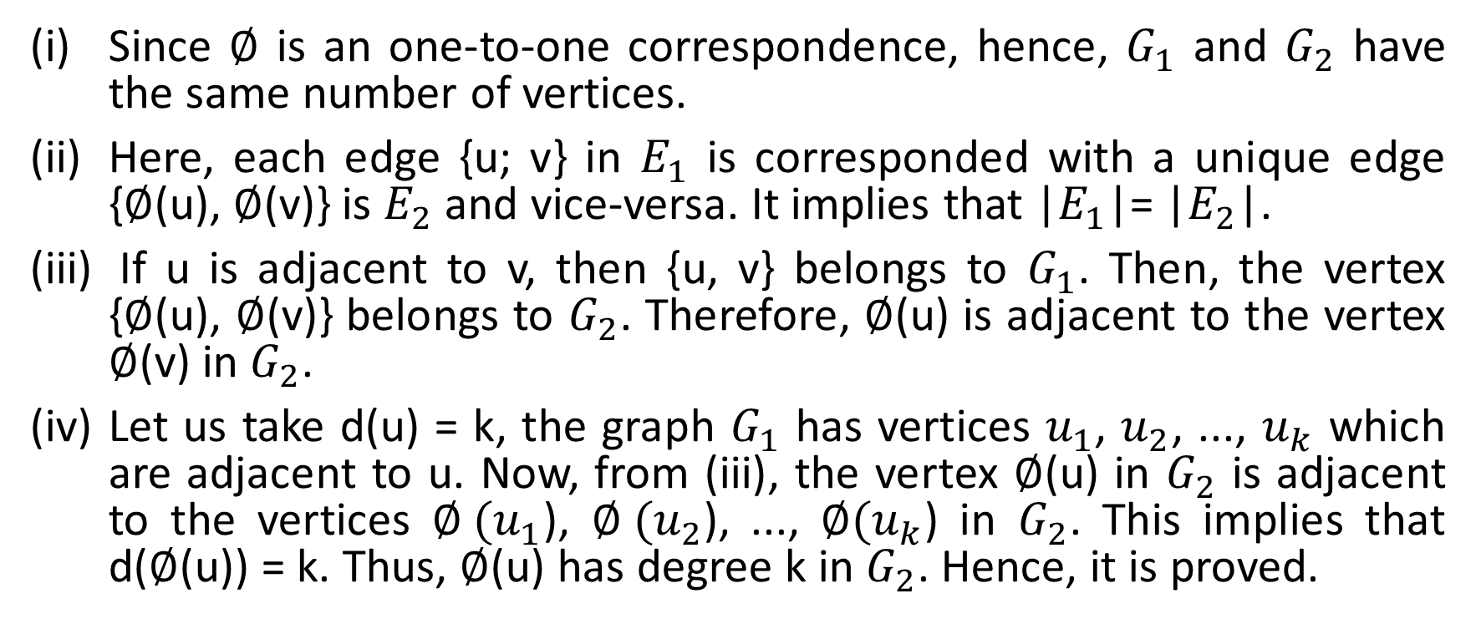
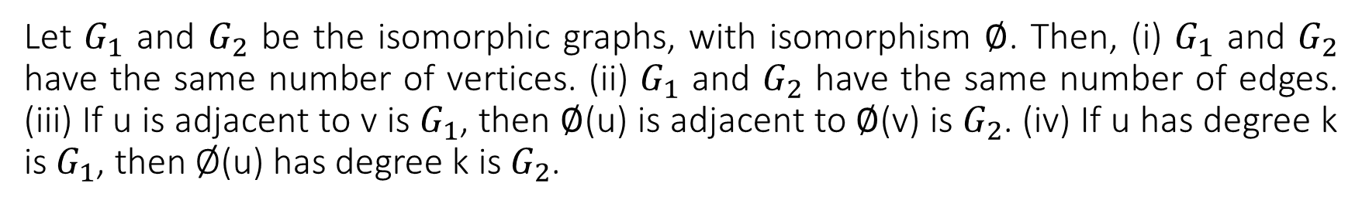
Let $G_{1}$ and $G_{2}$ be the isomorphic graphs, with isomorphism $∅$. Then, (i) $G_{1}$ and $G_{2}$ have the same number of vertices. (ii) $G_{1}$ and $G_{2}$ have the same number of edges. (iii) If u is adjacent to v is $G_{1}$, then $∅$(u) is adjacent to $∅$(v) is $G_{2}$. (iv) If u has degree k is $G_{1}$, then Ø(u) has degree k is $G_{2}$.
Since $∅$ is an one-to-one correspondence, hence, $G_{1}$ and $G_{2}$ have the same number of vertices.
Here, each edge {u; v} in $E_{1}$ is corresponded with a unique edge {$∅$(u), $∅$(v)} is $E_{2}$ and vice-versa. It implies that |$E_{1}$|= |$E_{2}$|.
If u is adjacent to v, then {u, v} belongs to $G_{1}$. Then, the vertex {$∅$(u), $∅$(v)} belongs to $G_{2}$. Therefore, $∅$(u) is adjacent to the vertex $∅$(v) in $G_{2}$.
Let us take d(u) = k, the graph $G_{1}$ has vertices $u_{1}$, $u_{2}$, ..., $u_{k}$ which are adjacent to u. Now, from (iii), the vertex $∅$(u) in $G_{2}$ is adjacent to the vertices $∅ (u_{1}$), $∅ (u_{2}$), ..., ${∅(u}_{k}$) in $G_{2}$. This implies that d($∅$(u)) = k. Thus, $∅$(u) has degree k in $G_{2}$. Hence, it is proved.

Slide 7
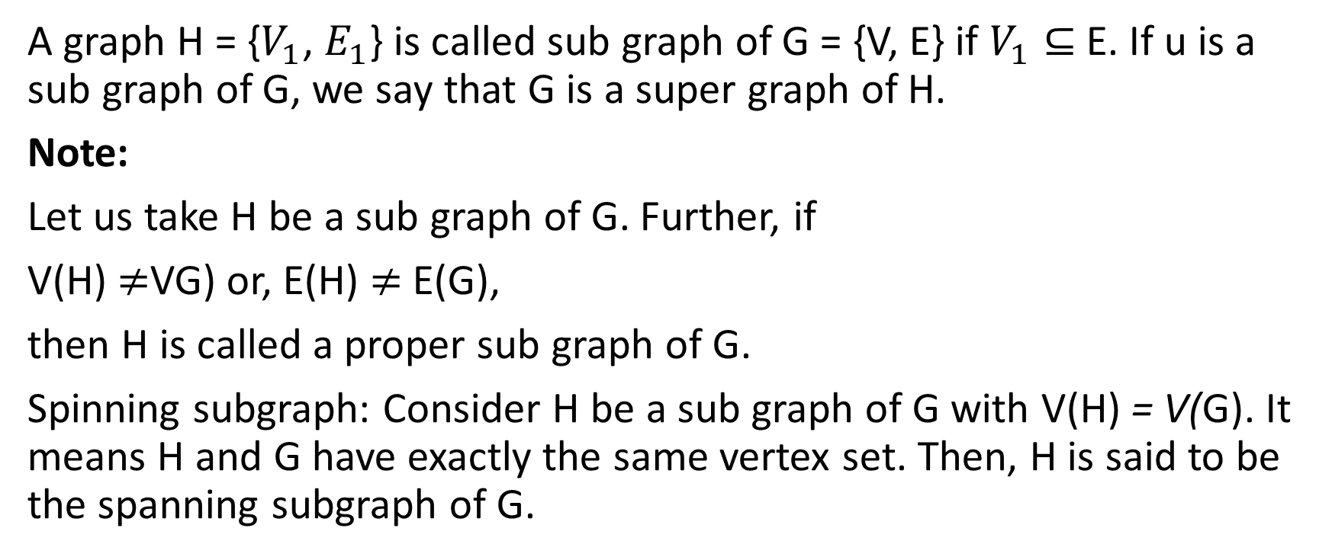
Subgraphs
A graph H = {$V_{1}$, $E_{1}$} is called sub graph of G = {V, E} if $V_{1}⊆$ E. If u is a sub graph of G, we say that G is a super graph of H.
Note:
Let us take H be a sub graph of G. Further, if
V(H) $≠$VG) or, E(H) $≠$ E(G),
then H is called a proper sub graph of G.
Spinning subgraph: Consider H be a sub graph of G with V(H) = V(G). It means H and G have exactly the same vertex set. Then, H is said to be the spanning subgraph of G.

Slide 8
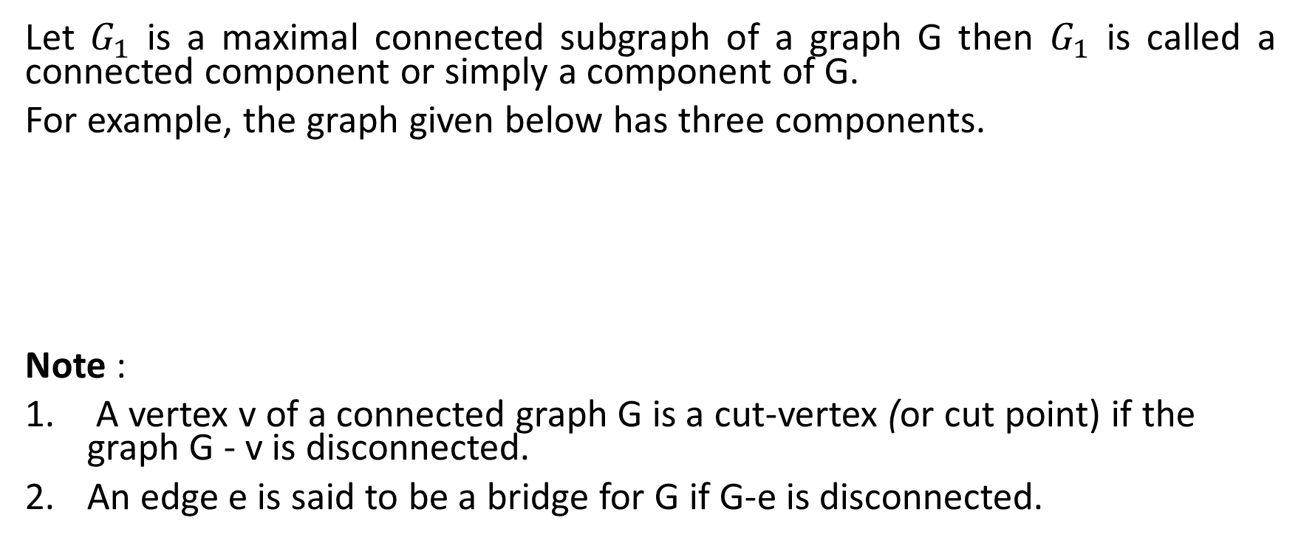
Component of a graph
Let $G_{1}$ is a maximal connected subgraph of a graph G then $G_{1}$ is called a connected component or simply a component of G.
For example, the graph given below has three components.
Note :
A vertex v of a connected graph G is a cut-vertex (or cut point) if the graph G - v is disconnected.
An edge e is said to be a bridge for G if G-e is disconnected.

Slide 9
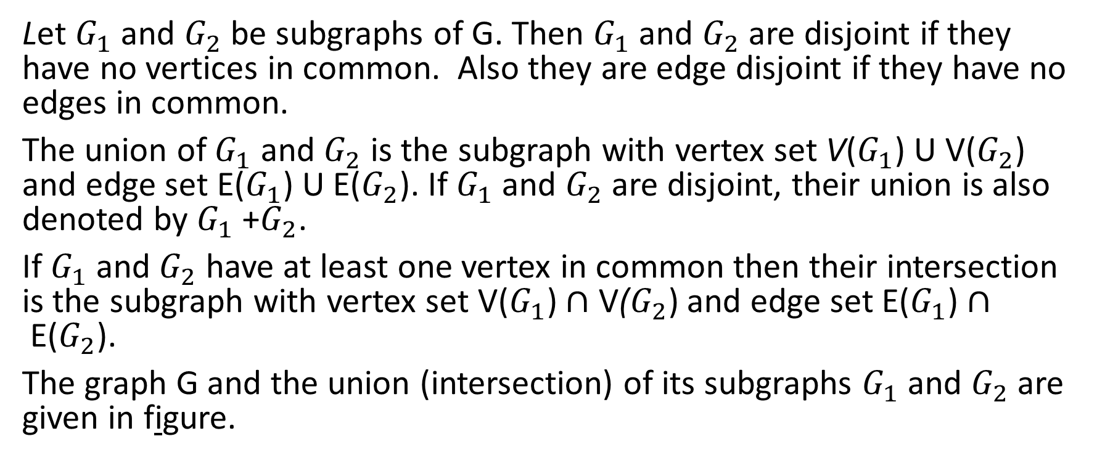
Operations on Graphs
Let $G_{1}$ and $G_{2}$ be subgraphs of G. Then $G_{1}$ and $G_{2}$ are disjoint if they have no vertices in common. Also they are edge disjoint if they have no edges in common.
The union of $G_{1}$ and $G_{2}$ is the subgraph with vertex set V($G_{1}$) U V($G_{2}$) and edge set E($G_{1}$) U E($G_{2}$). If $G_{1}$ and $G_{2}$ are disjoint, their union is also denoted by $G_{1}$ +$G_{2}$.
If $G_{1}$ and $G_{2}$ have at least one vertex in common then their intersection is the subgraph with vertex set V($G_{1}$) $∩$ V($G_{2}$) and edge set E($G_{1}$) $∩$E($G_{2}$).
The graph G and the union (intersection) of its subgraphs $G_{1}$ and $G_{2}$ are given in figure.

Slide 10




Operations on Graphs
$$G_{1}$$
$$G_{2}$$
$$G_{1}∪G_{2}$$
$G_{1}$ $∩G_{2}$

Slide 11
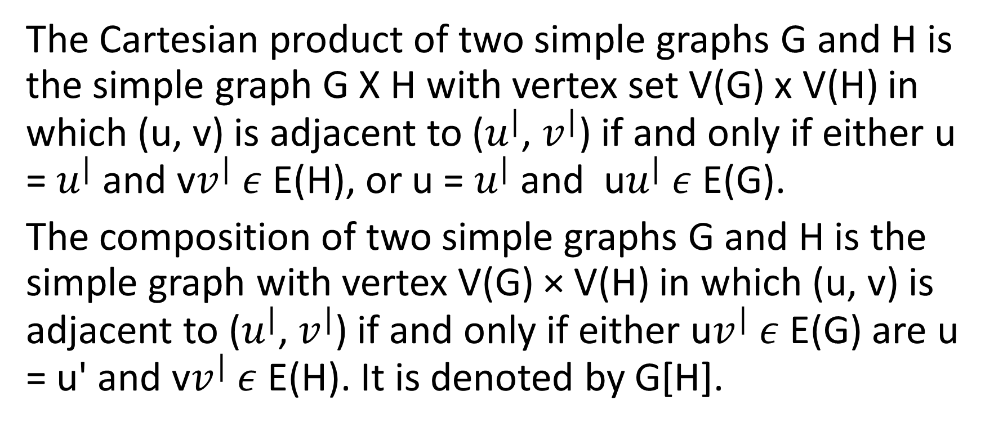
Cartesian product of graphs
The Cartesian product of two simple graphs G and H is the simple graph G X H with vertex set V(G) x V(H) in which (u, v) is adjacent to ($u^{|}$, $v^{|}$) if and only if either u = $u^{|}$ and v$v^{|}$ $ε$ E(H), or u = $u^{|}$ and u$u^{|}$ $ε$ E(G).
The composition of two simple graphs G and H is the simple graph with vertex V(G) × V(H) in which (u, v) is adjacent to ($u^{|}$, $v^{|}$) if and only if either u$v^{|}$ $ε$ E(G) are u = u' and v$v^{|}$ $ε$ E(H). It is denoted by G[H].

Slide 12
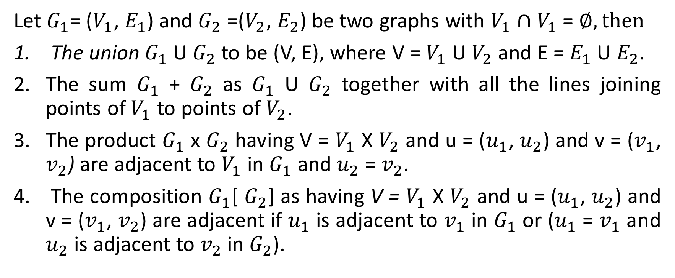
Note:
Let $G_{1}$= ($V_{1}$, $E_{1}$) and $G_{2}$ =($V_{2}$, $E_{2}$) be two graphs with $V_{1}$ $∩V_{1}$ = $∅, then$
The union $G_{1}$ U $G_{2}$ to be (V, E), where V = $V_{1}$ U $V_{2}$ and E = $E_{1}$ U $E_{2}$.
The sum $G_{1}$ + $G_{2}$ as $G_{1}$ U $G_{2}$ together with all the lines joining points of $V_{1}$ to points of $V_{2}$.
The product $G_{1}$ x $G_{2}$ having V = $V_{1}$ X $V_{2}$ and u = ($u_{1}$, $u_{2}$) and v = ($v_{1}$, $v_{2}$) are adjacent to $V_{1}$ in $G_{1}$ and $u_{2}$ = $v_{2}$.
The composition $G_{1}$[ $G_{2}$] as having V = $V_{1}$ X $V_{2}$ and u = ($u_{1}$, $u_{2}$) and v = ($v_{1}$, $v_{2}$) are adjacent if $u_{1}$ is adjacent to $v_{1}$ in $G_{1}$ or ($u_{1}$ = $v_{1}$ and $u_{2}$ is adjacent to $v_{2}$ in $G_{2}$).

Slide 13
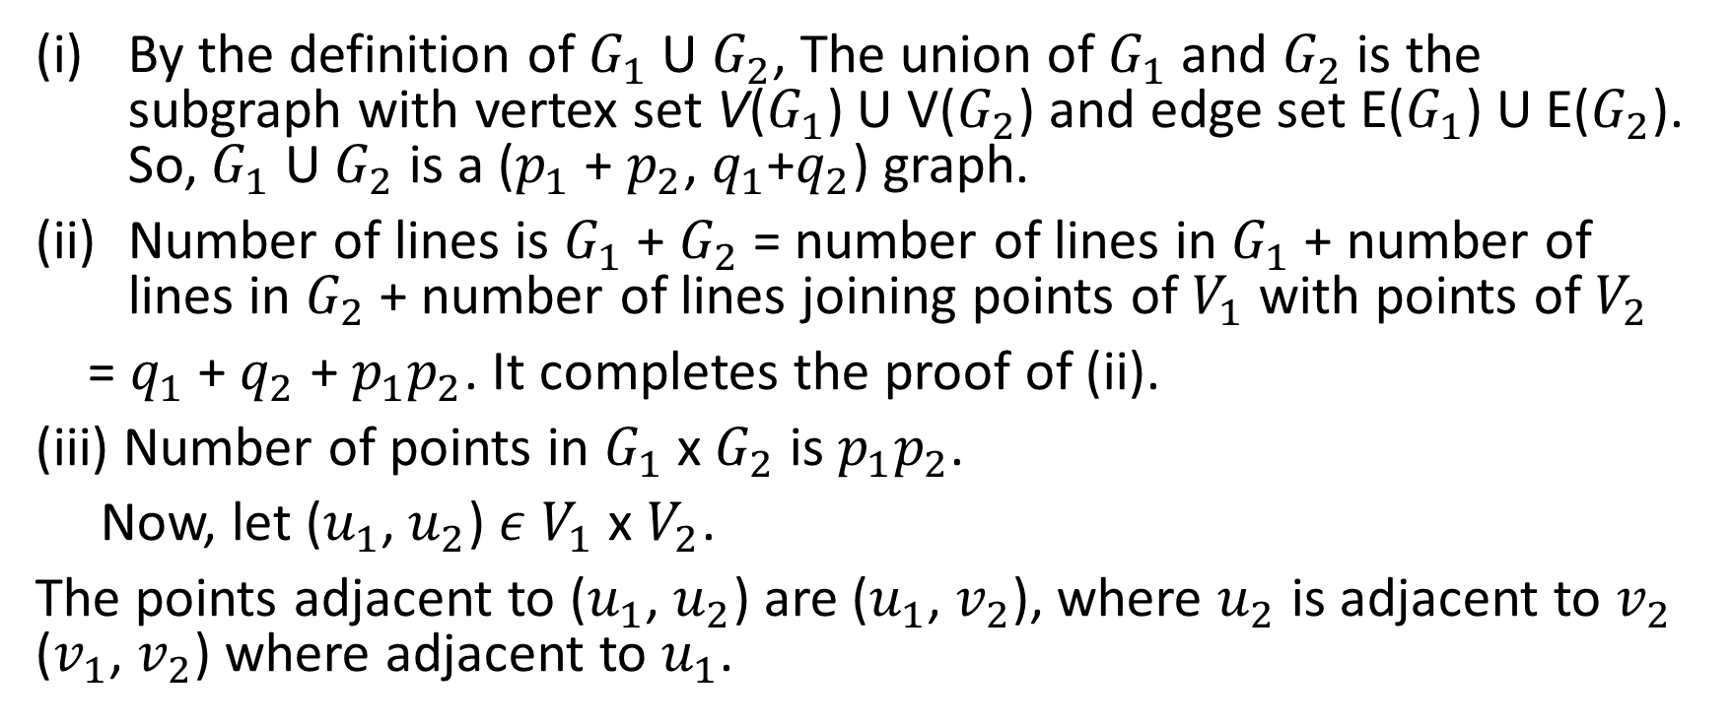
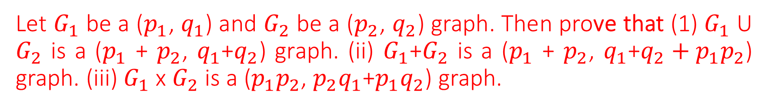
Let $G_{1}$ be a ($p_{1}$, $q_{1}$) and $G_{2}$ be a ($p_{2}$, $q_{2}$) graph. Then prove that (1) $G_{1}$ U $G_{2}$ is a ($p_{1}$ + $p_{2}$, $q_{1}$+$q_{2}$) graph. (ii) $G_{1}$+$G_{2}$ is a ($p_{1}$ + $p_{2}$, $q_{1}$+$q_{2}+p_{1}p_{2}$) graph. (iii) $G_{1}$ x $G_{2}$ is a ($p_{1}p_{2}$, $p_{2}q_{1}$+$p_{1}q_{2}$) graph.
By the definition of $G_{1}$ U $G_{2}$, The union of $G_{1}$ and $G_{2}$ is the subgraph with vertex set V($G_{1}$) U V($G_{2}$) and edge set E($G_{1}$) U E($G_{2}$). So, $G_{1}$ U $G_{2}$ is a ($p_{1}$ + $p_{2}$, $q_{1}$+$q_{2}$) graph.
Number of lines is $G_{1}$ + $G_{2}$ = number of lines in $G_{1}$ + number of lines in $G_{2}$ + number of lines joining points of $V_{1}$ with points of $V_{2}$
= $q_{1}$ + $q_{2}$ + $p_{1}p_{2}$. It completes the proof of (ii).
(iii) Number of points in $G_{1}$ x $G_{2}$ is $p_{1}p_{2}$.
Now, let ($u_{1}$, $u_{2}$) $ε$ $V_{1}$ x $V_{2}$.
The points adjacent to ($u_{1}$, $u_{2}$) are ($u_{1}$, $v_{2}$), where $u_{2}$ is adjacent to $v_{2}$ ($v_{1}$, $v_{2}$) where adjacent to $u_{1}$.

Slide 14
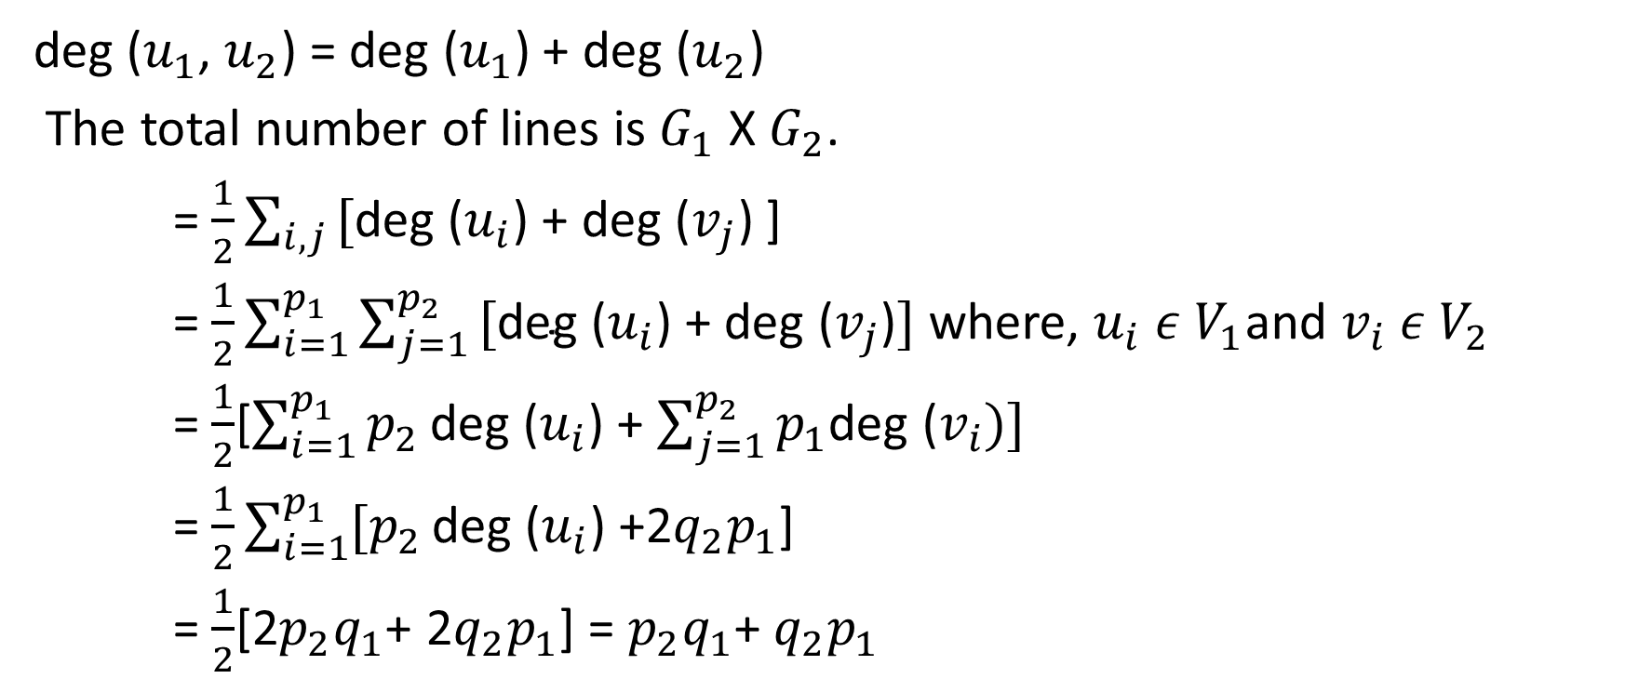
Continued…
deg ($u_{1}$, $u_{2}$) = deg ($u_{1}$) + deg ($u_{2}$)
The total number of lines is $G_{1}$ X $G_{2}$.
= $\frac{1}{2}\sum_{i, j}{\text{[}\text{deg}\text{ (}u_{i}\text{) + }\text{deg}\text{ (}v_{j}\text{) }}$]
= $\frac{1}{2}\sum_{i=1}^{p_{1}}{\sum_{j=1}^{p_{2}}{\text{[}\text{deg}\text{ (}u_{i}\text{) + }\text{deg}\text{ (}v_{j}\text{)}]}}$ where, $u_{i}$ $ε$ $V_{1}$and $v_{i}$ $ε$ $V_{2}$
= $\frac{1}{2}$[$\sum_{i=1}^{p_{1}}{p_{2}}\text{deg}\text{ (}u_{i}$) + $\sum_{j=1}^{p_{2}}{p_{1}\text{deg}\text{ (}v_{i})]}$
= $\frac{1}{2}\sum_{i=1}^{p_{1}}{{[p}_{2}}\text{deg}\text{ (}u_{i}$) +2$q_{2}p_{1}$]
= $\frac{1}{2}$[2$p_{2}q_{1}$+ 2$q_{2}p_{1}$] = $p_{2}q_{1}$+ $q_{2}p_{1}$

Slide 15


